Slide 1
CSE438 : Data Science
Task 2 : Paper Review
Paper title : Unveiling the Black Box: The Need for Explainable AI (XAI)
Name : Sumit Haldar ID : 20101544

Slide 2
Unveiling the Black Box: The Need for Explainable AI (XAI)
Overview:
Fourth Industrial Revolution: Rapid AI Integration
Challenge: Lack of Transparency in AI Systems
Importance of XAI:
Building Trust and Transparency
Essential for Steady AI Progress
Survey Focus :
Current Approaches to XAI
Emerging Trends and Industry Adoption

Slide 3
Introduction
AI is democratizing everyday life, with global investment expected to grow from 12 billion to 52.2 billion dollars by 2021. However, AI algorithms struggle with opacity, especially Machine Learning algorithms. Explainable Artificial Intelligence (XAI) proposes a shift towards transparent AI, aiming to produce explainable models while maintaining high performance levels. Key players include FAT* academics and DARPA-funded researchers.
Introducing Explainable AI (XAI):
- Addressing the Transparency Issue
- Suite of Techniques for More Explainable Models with High Performance
Impact on Society:
- Ubiquitous AI in Daily Life: Netflix, Amazon, Facebook, Google
- Critical Decisions Require Explanation, Especially in Disease Diagnosis
Challenges with AI Algorithms:
- Opacity of AI Algorithms, Particularly Machine Learning (ML)
- Entrusting Decisions to Unexplainable Systems Poses Dangers

Slide 4
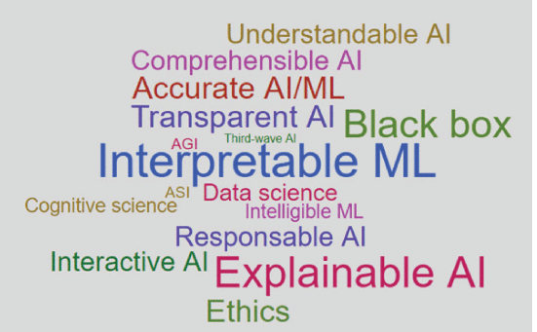
Background
Renewed Interest and Resurgence in XAI:
- Google Trends highlights a recent surge in XAI research.
- Driven by AI's pervasive impact on critical decision-making without transparent reasoning.
Diverse Definitions of XAI:
- No universally accepted definition; reflects movements and initiatives.
- DARPA emphasizes balanced models with high learning performance.
- FAT* focuses on non-technical explanation of algorithmic decisions.
- FICO sees XAI as an innovation for trustworthy explanations in ML.
The Importance of Deep Understanding:
- Beyond colloquial definitions, gaining profound insights into XAI.
- Proposal: Explore key concepts shaping the landscape for a comprehensive understanding.
Literature Scan and Linguistic Search:
- Identifying relevant terms across research communities.
- Word cloud analysis provides an intuitive grasp of XAI's scope and related concepts.
- Frequency-ordered terms unveil the landscape, filtering out technical terms for clarity.

Slide 5
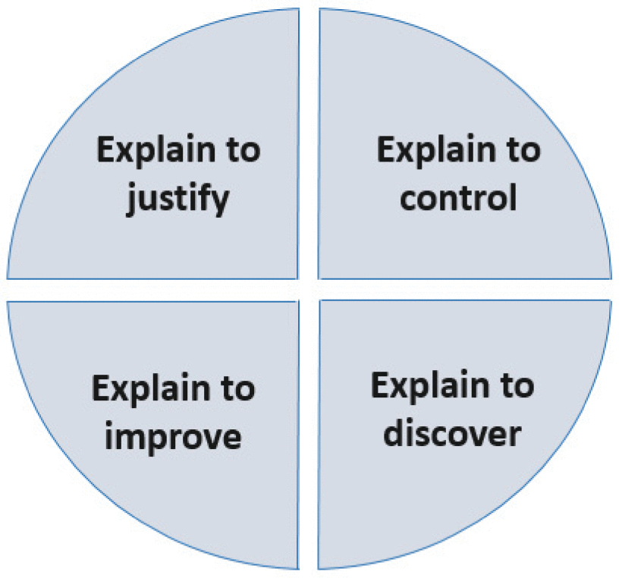
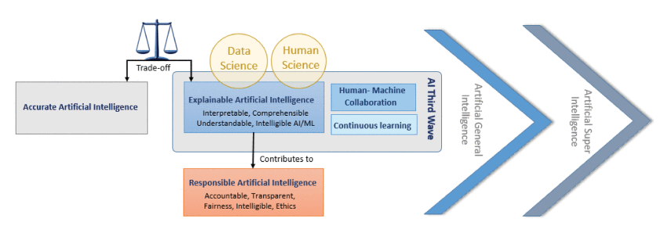
Methodology
LIME (Local Interpretable Model-Agnostic Explanations):
LIME generates interpretable models for complex AI models on a local level. It approximates the decision boundary around a specific instance, providing insights into the model's behavior for individual predictions. This methodology is particularly useful for enhancing understanding in situations where a detailed explanation is needed at the instance level.
SHAP (SHapley Additive exPlanations):
SHAP values quantify the contribution of each feature to a model's prediction. By applying cooperative game theory principles, SHAP provides a fair distribution of feature importance. This methodology aids in discerning the impact of individual features on AI decisions, promoting transparency and interpretability in complex models.
Rule-Based Explanations:
Rule-based explanations derive human-readable rules to elucidate AI decisions. These explicit rules provide a transparent representation of the decision-making process, making it easier for users to comprehend the factors influencing predictions. This methodology contributes to trust-building by offering clear and understandable guidelines for AI-driven outcomes.
Reasons for XAI
A schematic view of XAI related concepts

Slide 6
XAI Application Domains
Transportation:
- Autonomous vehicles require explainability for safety, as seen in incidents like the self-driving Uber accident. XAI can clarify ambiguous situations, preventing dangerous consequences and building trust.
Healthcare:
- Black-box medical diagnosis models impact patient treatment decisions. Making clinical AI systems explainable is crucial for discovering and addressing critical issues, ensuring confidence in medical decision-making.
Legal:
- AI-driven risk assessment in criminal justice demands transparency for fairness. Cases like Loomis v. Wisconsin highlight the need for visibility into decision processes. Research is needed to make automated legal decision-making more transparent and accountable.
Finance:
- AI-based credit score decisions pose challenges in providing clear reasons for denial. Ongoing research projects aim to generate automated reason codes, enhancing transparency and fairness in financial AI applications.
Military:
- AI-driven military operations raise ethical and legal dilemmas, requiring explainability for transparency. Initiatives like the DAPRA Ambitious XAI program address the need for transparency in military AI applications.
Emerging Domains:
- XAI finds potential applications in cybersecurity, education, entertainment, government, and image recognition. While initial works confirm XAI's need, extensive research is required to address the unique challenges in these diverse application domains.

Slide 7
Findings & Discussion
Scope and Selection Criteria:
- Challenge: The expansive spectrum of XAI approaches makes a comprehensive survey impractical.
- Solution: To ensure synthesis and relevance, a focused subset of 381 papers was meticulously selected. The criteria included popularity, impact, and recent trends.
Background Inclusion:
- Approach: A thorough background examination encompassed both traditional academic and non-academic sources.
- Rationale: Recognizing the youth and rapid evolution of the field, non-traditional sources were considered, as they wield significant influence and impact.
Concluding Insights:
- Summary of Findings: Culmination of key insights and notable facts derived from the extensive survey.
- Research Directions: A contemplative exploration of emerging research directions and open problems, offering a synthesized perspective on the field.
In advancing Explainable AI (XAI), our goal is to enhance collaboration and formalism. We propose a shared lexicon for smoother knowledge transfer, advocate for a unified explainable framework, and emphasize the importance of generalizing problem formulations for consistent evaluation metrics. Identifying a critical area for future work, we aim to develop rigorous evaluation methods in XAI, reducing the need to "explain explanation" and fostering a standardized and robust framework for the field.

Slide 8
Conclusion
This paper provides a comprehensive overview of XAI, an interdisciplinary research field in the AI ecosystem. It uses the Five W's and How to cover all aspects related to XAI. The survey reviews explainability approaches and finds XAI's impact extends to various application domains. However, there is a lack of formalism in problem formulation and human role studies in existing explainability approaches. Future efforts are needed to address XAI's challenges.

Slide 9
Thank you!

